Slide 1


Data Curriculum Case Study

Slide 2


First Some Good News

Slide 3
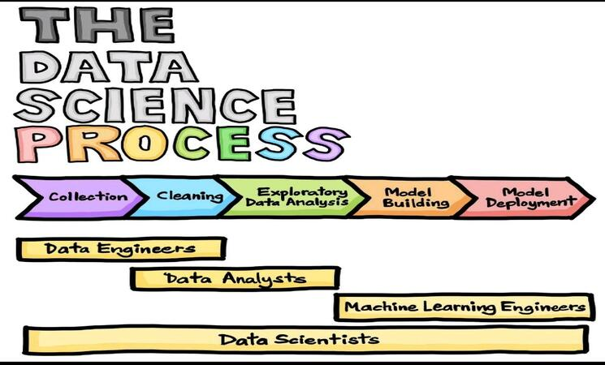
Data Storytelling

Slide 4
Class Schedule
Week 1 : Python
Week 2 : Transform/Load
Week 3 : Extraction
Week 4 : Descriptive Stats / Viz
Week 5 : Mathematical Methods
Week 6 : Supervised Learning
Week 7 : Unsupervised Learning
Week 8 : Deploy & More
Week 9 : Final Project

Slide 5
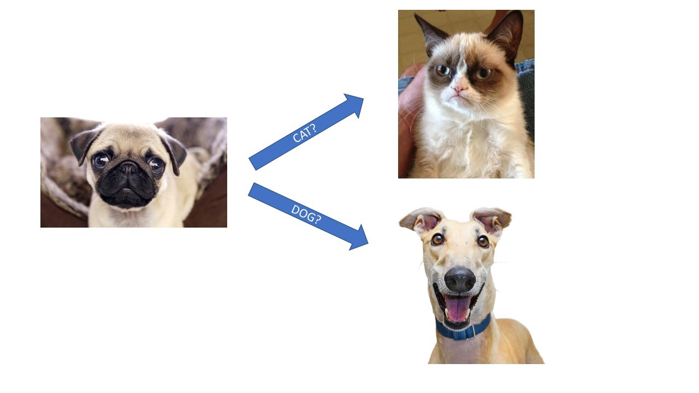
Logistic Regression

Slide 6
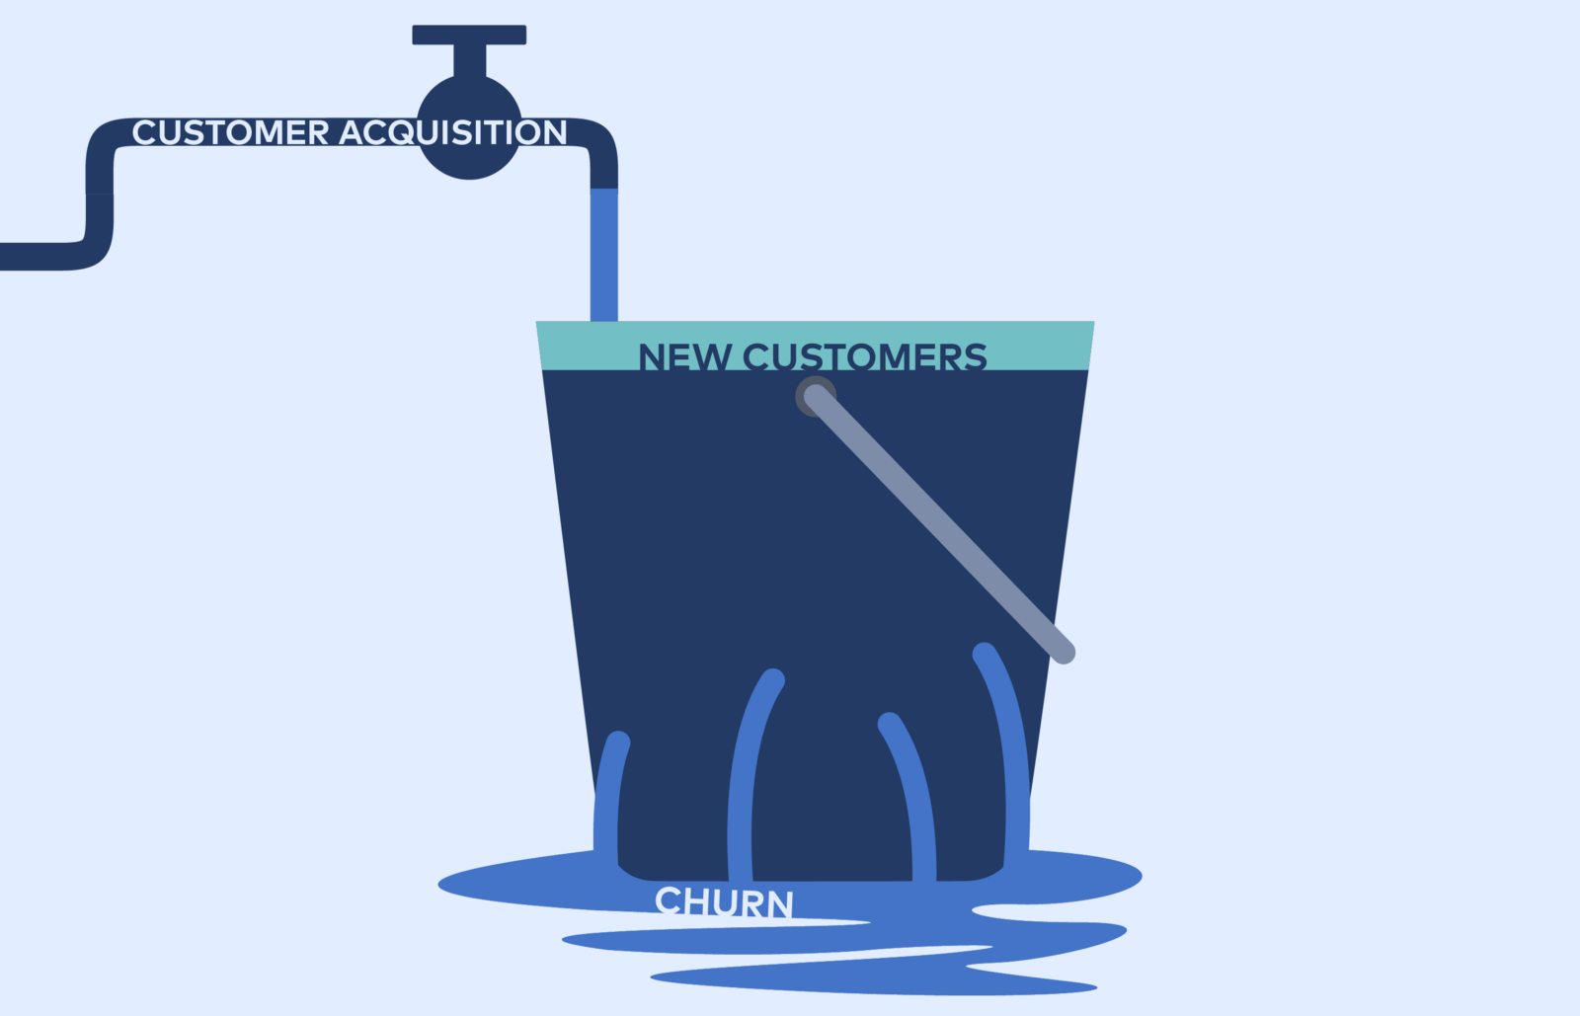
Logistic Regression

Slide 7
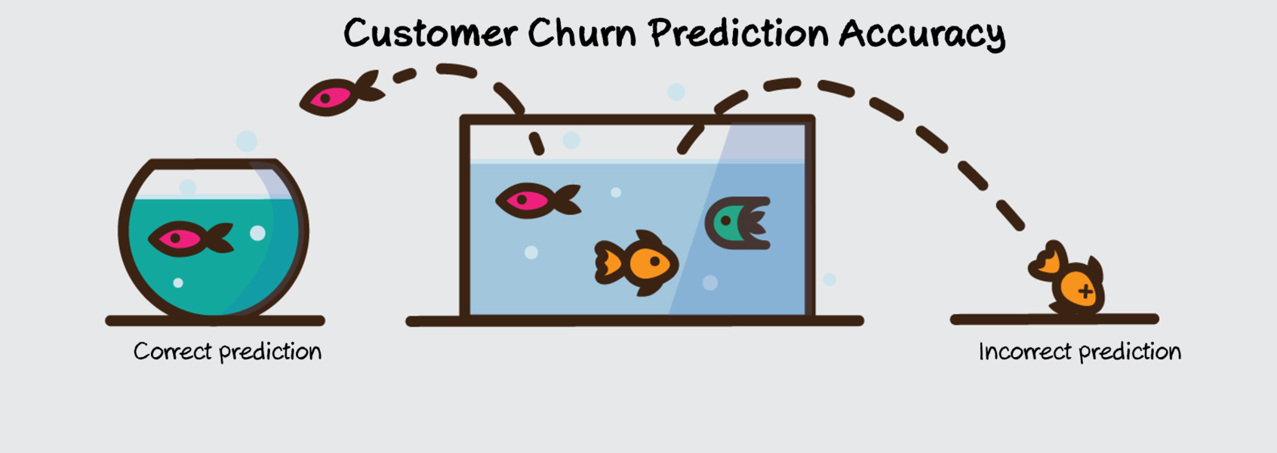
Logistic Regression

Slide 8
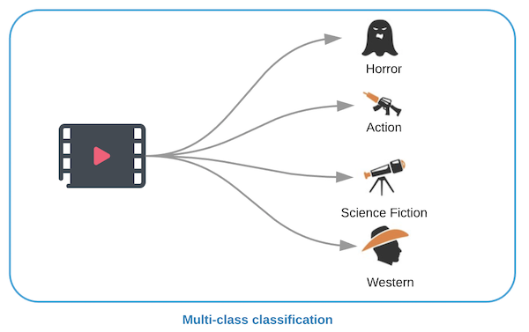
Logistic Regression Multilabel

Slide 9

Logistic Regression Multilabel

Slide 10

To Notebooks…

